Slide 1
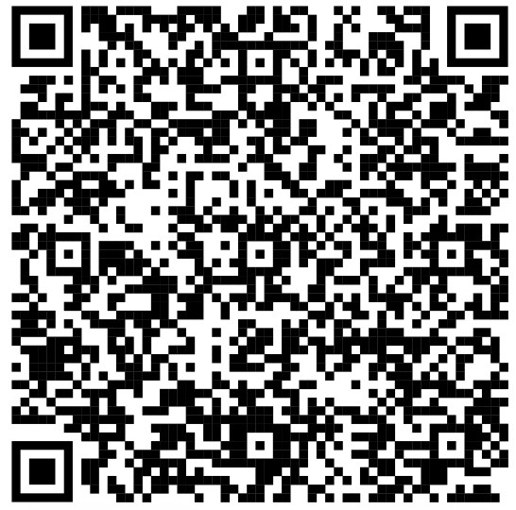
Asistencia

Slide 2


Git & VScode

Slide 3


Presenters
Kevin Avilés Rivera
Joel M. González Rodríguez

Slide 4
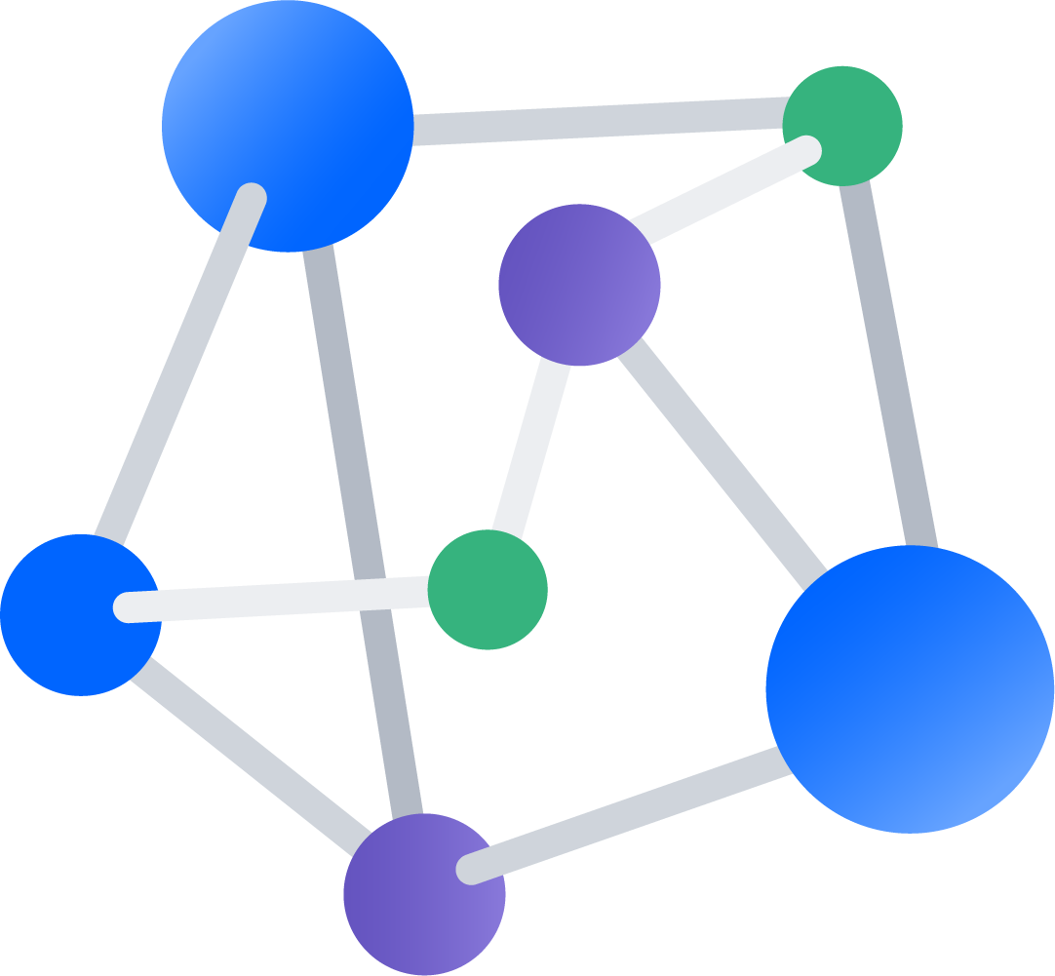
Version Control Software
1
What is Version Control Software?

Slide 5



Why is Version Control Software important?
Allows us to collaborate with other developers
We can track changes with ease
Gives us the ability to trace back errors and undo mistakes
Used by Software Developer teams in many companies

Slide 6
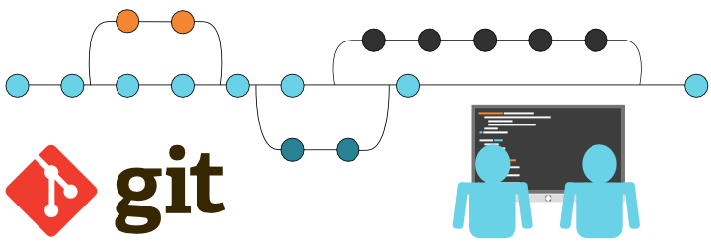
Git
Open-Source Version Control Software authored by Linus Torvalds
Utilized through a series of commands and workflows
Based on Repositories, Branches, and Commits
Why Git?
Standard in the Tech Industry
Huge community
Easy to learn
Free!
6

Slide 7
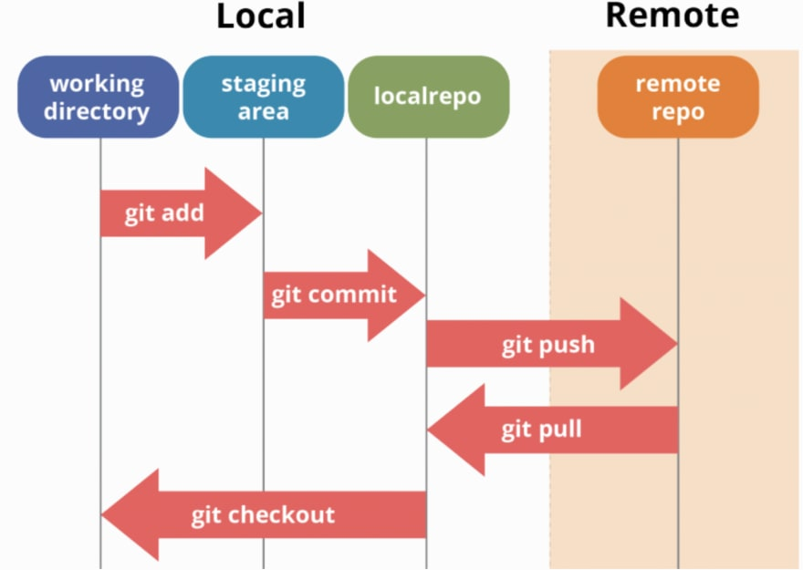

Slide 8
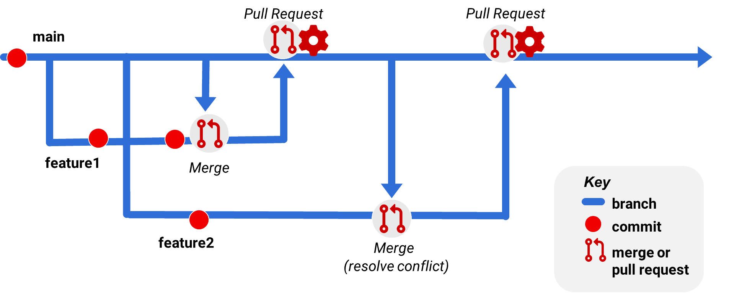
Git Workflows
Approaches for using Git effectively
Essential for Software Developer Teams
Organizes and structures the way we merge code between branches
Complex
Examples:
Gitflow
Feature Branches
Pull Request Workflow

Slide 9
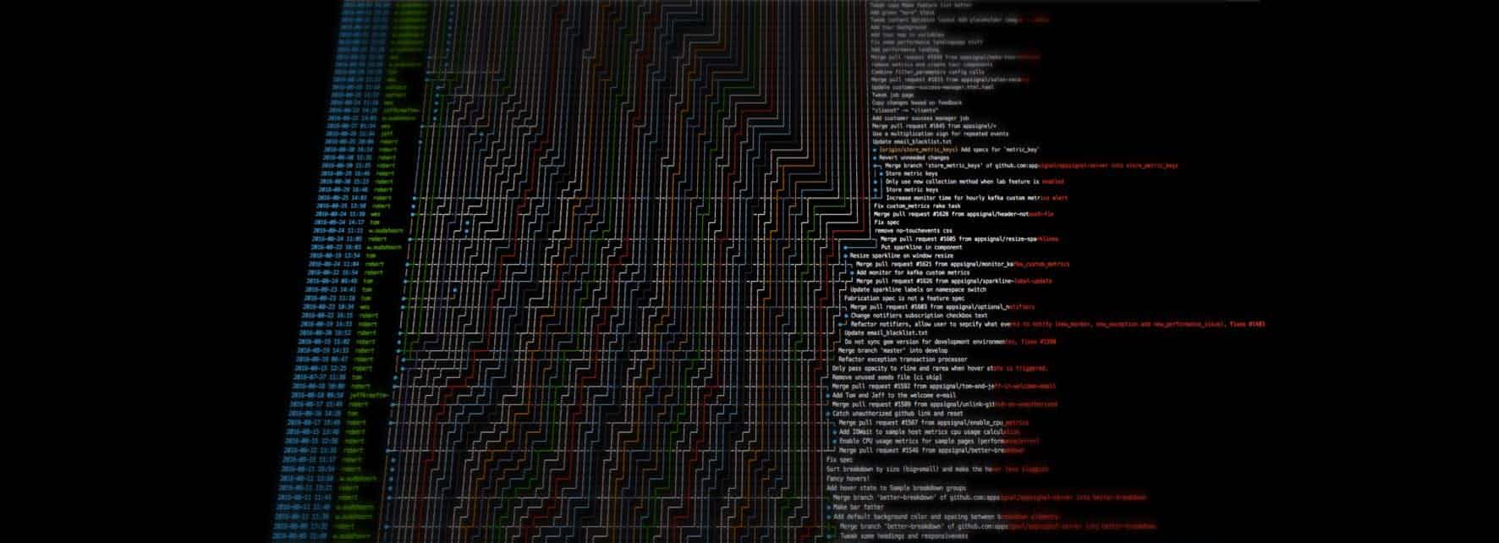
Git Repository with many branches

Slide 10

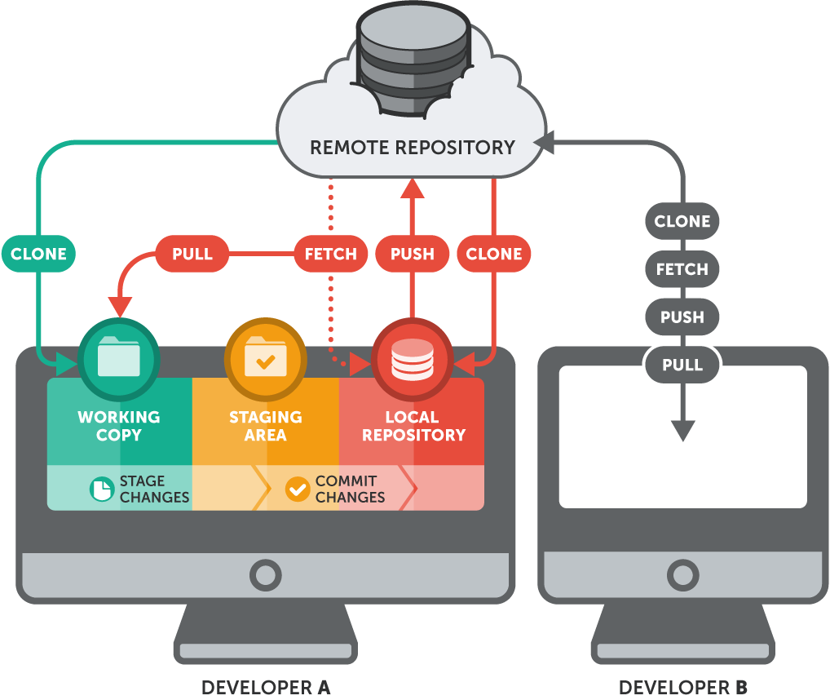
GitHub
GitHub functions as a web-based platform and cloud service designed to facilitate developers in the storage and administration of their codebases it also allows developers to monitor changes made to their software.
Git is a VCS that allows users to manage and keep track of their source code history.

Slide 11

GitLab
GitLab is a web-based Git repository which allows users to store and manage their codebases similar to GitHub.
The main difference is that Gitlab has continuous integration/ continuous delivery (CI/CD) and DevOps workflows built in.
Whereas GitHub lets you work with the (CI/CD) tools of your choice.

Slide 12






Why should I create a GitHub Account?

Slide 13
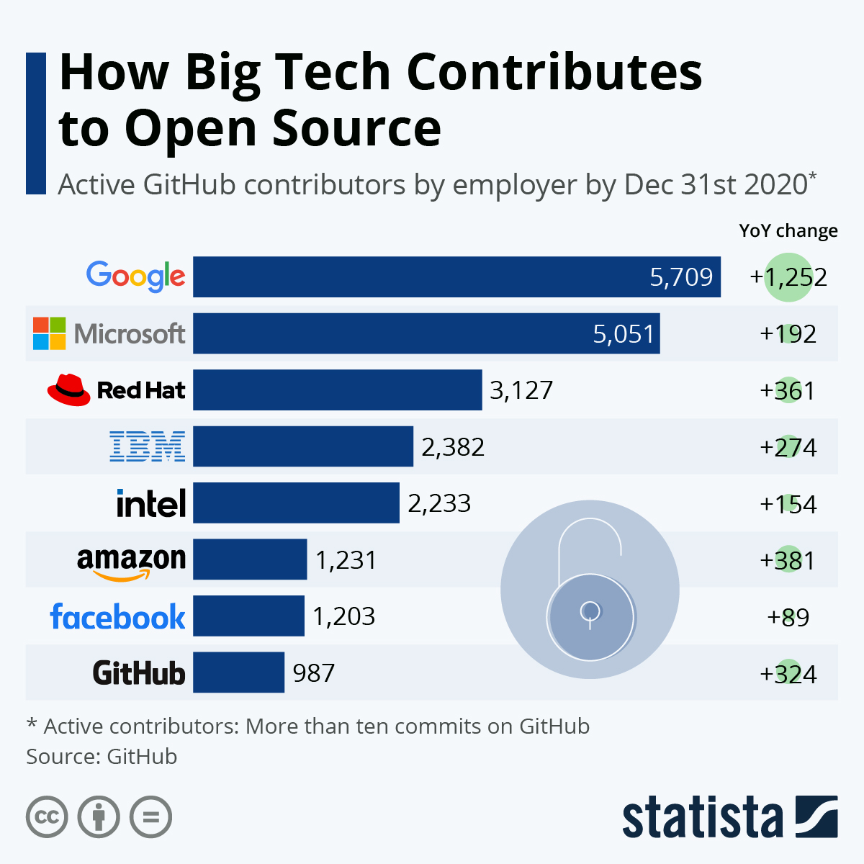
Open-Source Software
2

Slide 14






Popular Open-Source Software
Linux
Gimp
Firefox
FileZilla
7-Zip
OBS

Slide 15

How can I contribute to OSS
Organize meetings between collaborators
Review code others have submitted
Write & Improve documentation

Slide 16

Visual studio code
3

Slide 17
What is Visual Studio Code?
Key Features:
Debugging support
Syntax highlighting
Intelligent code completion
Code snippets
Code refactoring tools
Integrated Git support
Extension support

Slide 18



Most popular extensions
Prettier
Git lens
TODO Highlight

Slide 19

Live Demonstration
4
Set up a local and remote repository
Push code to GitHub

Slide 20
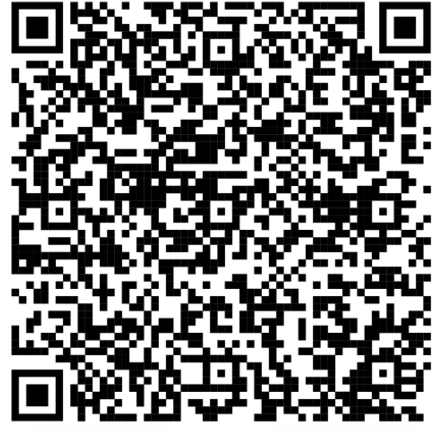
GitHub Repo

Slide 21








Elevator Pitch
Visual Studio
GitHub
Resume Building
10/octubre/2023
12/septiembre/2023
TALLERES
26/septiembre/2023
TIMELINE

Slide 22

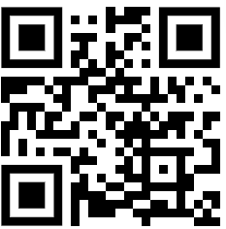
Follow our socials!

Slide 23
THANKS!
Any questions?
You can find us at:
Kevin Avilés: kevin.aviles6@upr.edu
Joel M. González: joel.gonzalez35@upr.edu

